Slide 1
Being An Emotionally Available Adult
Talking with children and teenagers in ways that help

Slide 2
Aims
Helping you and staff to:
Support children and young people to talk about feelings
Understand how to listen empathetically
Reflect on ways to respond to questions
Develop scripts and key messages to create a supportive environment
Remember that you are already skilled at relating to and communicating with children and young people.
This e-module is an opportunity to build confidence and further develop your skills.

Slide 3
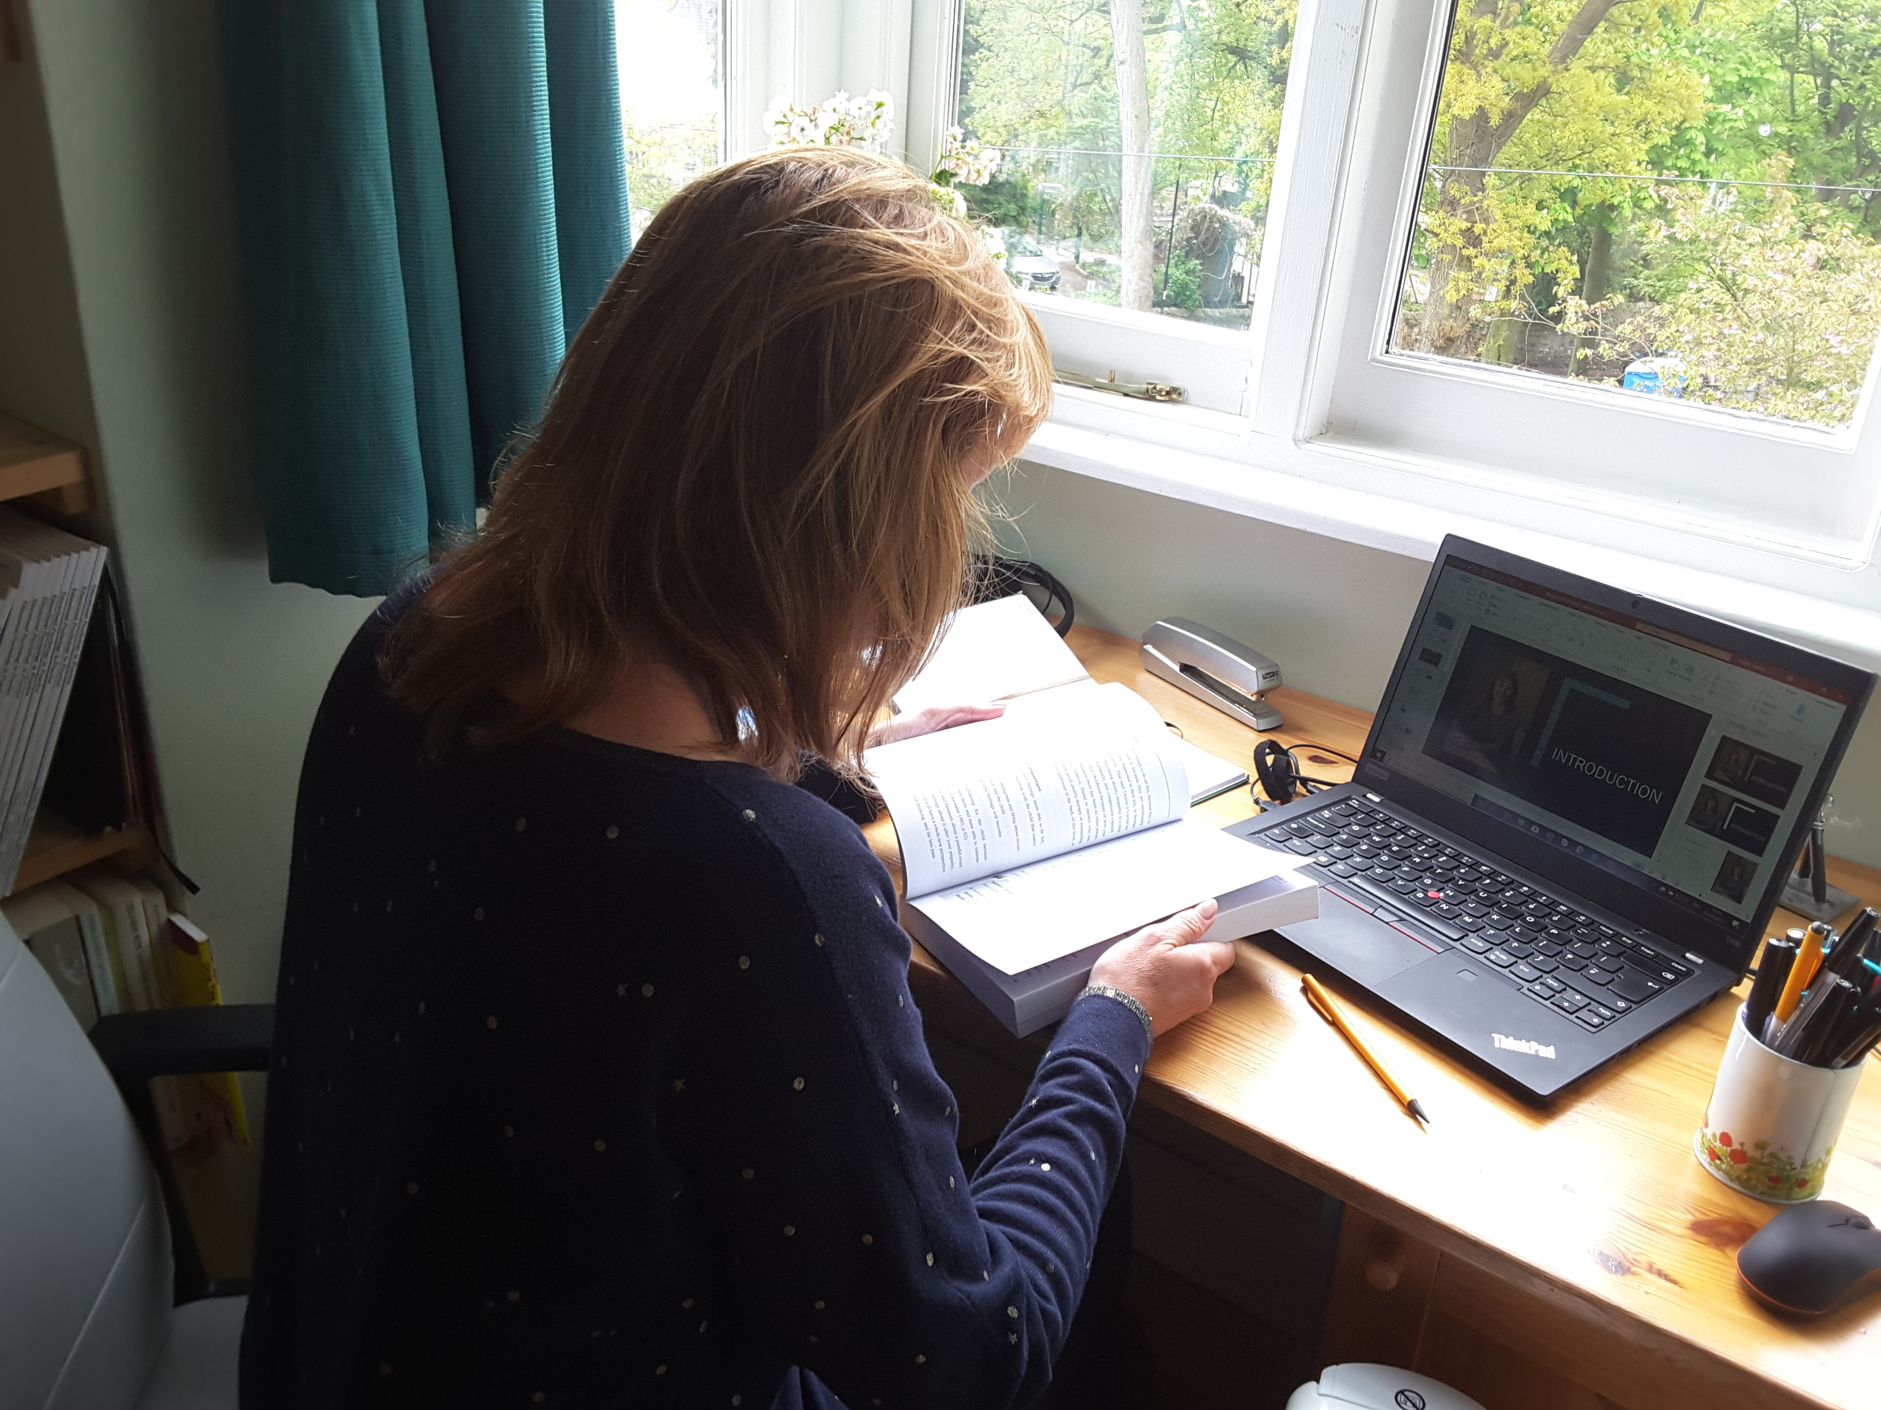
Introduction

Slide 4
Being the Emotionally Available Adult
Having just one emotionally available adult before the age of 18 can make a huge difference to a child’s wellbeing.
When we talk with children and young people about their feelings:
People learn to reflect on their feelings rather than ‘behave’ them
People can develop their emotional vocabulary
People learn to ‘open up’ and accept comfort
People feel safe and know that others care

Slide 5
How am I feeling?
Think about your own thoughts and feelings over the past few days and make a note of them.
Who do you talk to about your feelings?
What does the person say and do that helps?
The skills you reflected upon are all needed in our interactions with children and young people

Slide 6
Mirror neurons
We are social beings and we copy the emotions of others.
When people smile, we smile. When people panic, we panic.
Whenever possible, promote being a calm and positive role model.

Slide 7
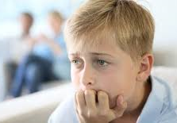
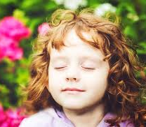
All emotions are normal and natural
Children and young people will come into schools and settings with a range of feelings: excited, scared, happy, sad…
Most children and young people won’t need specialist support, but they will benefit from an ‘emotionally available’ adult who takes time to listen, helps to name feelings and to reassure.

Slide 8
Key themes and scripts to use with children and young people
All Feelings are Normal and Natural
‘It’s okay to have the feelings you are having; these are normal and natural’;
‘Different people have different feelings, at different intensities, at different times and this is okay’
Hope and Resilience
‘We are all being brave’; ‘We are following the rules to help others’;
‘ …by doing this we are saving lives’
Sense of Safety and Belonging
‘It is important to be kind to each other’; ‘We are looking after each other’;
‘Adults at school are here to help and talk to you about any worries you may have’

Slide 9
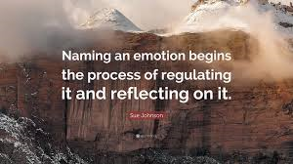
Supporting children and young people to reflect on feelings
Putting words to feelings helps to calm and soothe
Reassure all feelings are normal
- “No wonder you … of course you…”
Be curious and show empathy about hurt
- “I’m so sorry…”
Try using a soothing, rhythmic voice
Affect Labelling: naming emotions to calm and regulate

Slide 10
Receiving and reflecting feelings
Step 1: Think, feel and imagine what it must feel like for the individual:
- “I wonder if…I imagine…I’ve noticed…”
Step 2: Gently enquire to find out more:
- “Can you tell me a bit more about that?”
Step 3: Find the right words and tone to reassure and convey empathy:
- “Of course you feel…you are very brave…thank you for sharing
…we are all looking after each other”
(Adapted from Sunderland, M, 2015, Conversations that Matter, Chapter 3)
Notes:
Jo 1
You can draw out the importance of ‘emotional literacy’ – which applies to children and adults alike.
Jo 1 min
Our knowledge of ourselves, the understanding and expression of our feelings and their regulation are a key component within self esteem which links with self-empowerment

Slide 11
Skills practice
Think about words that you would use to respond to the following:
“I’m worried about my nannan, she has health needs”
“I preferred being at home”
“I’m scared that I’m going to get ill”
“I’m sad that there will never be a cure”
“I’m not bothered, I just want to be with my mates”
Remember, it’s okay to say, “I don’t know” and reflect back the key message that, “We are all looking after each other.”.

Slide 12
Being AN EMOTIONALY AVAILABLE ADULT EXAMPLES

Slide 13
Ways to create time to talk with children and young people
Morning arrival - warm welcome, informally connect with each person
Emotional ‘check in’ - provide emotional templates and charts so that children and young people can indicate how they are feeling at that time (but bear in mind that feelings are ever-changing)
Circle time - balance of activities, serious and lighter games
PSHE sessions
One-to-one mentoring - safe spaces and adults who are available (drop-in and fixed times)
Home time - provide reassurance and positive messages to the class group
Open communication with families

Slide 14
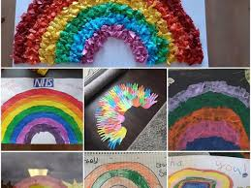
Using creative arts to express feelings
What creative skills can you draw upon in your school or setting to help children and young people express their feelings?
art and craft
story books
video clips
puppets
music
drama
dance

Slide 15
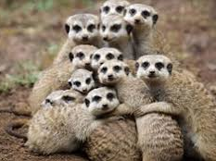
Emotional support helps to ‘contain’ emotions
Emotional Containment:
Adults being able to understand the child’s emotions and soothe and comfort so the child is no longer overwhelmed
It’s a bit like providing a container for milk; without a container, the milk spills everywhere. When it’s contained, it’s the same milk, but it’s contained and not overwhelming

Slide 16
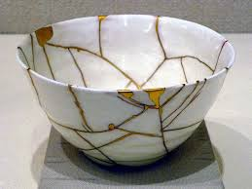
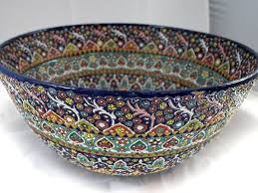
Final reflection - CONTAINMENT Quiz: Which of the bowls pictured do you Feel Is THE MOST VALUABLE?

Slide 17
Kintsugi art
The bowl pictured is from the Japanese art form, ‘Kintsugi’. It has history and has been damaged and broken; it has been repaired with gold and this makes it more beautiful.
Together we can support and ‘contain’ each other when we are ‘broken’ and be the ‘gold’ that helps us to stay strong.

Slide 18
Further Reading and Resources
British Psychological Society, ‘Talking to Children about Coronavirus’; https://www.bps.org.uk/sites/www.bps.org.uk/files/Policy/Policy%20-%20Files/Talking%20to%20children%20about%20coronavirus.pdf
UNICEF, ‘How teachers can talk to children about coronavirus’; https://www.unicef.org/coronavirus/how-teachers-can-talk-children-about-coronavirus-disease-covid-19
Margot Sunderland (2015). Conversations that Matter, talking with children and teenagers in ways that help, Worth Publishing
Adele Faber and Elaine Mazlish (2012). How to Talk so Kids Will Listen and Listen so Kids Will Talk, Piccadilly Press
The Art of Brilliance - check out their podcasts on positive psychology

