Slide 1



SUPPORTING STAFF AND STUDENT WELLBEING
Post-lockdown

Slide 2


The Context
Before and after COVID
In 2017, the Government published its Green Paper for Transforming children and young people’s mental health, which detailed proposals for expanding access to mental health care for children and young people
As a result a joint initiative between the NHS and DfE has seen the development of Mental Health Support Teams (MHSTs) – with Doncaster and Rotherham being one of the first 25 Trailblazer areas; announced December 2018 and recently underway locally

Slide 3
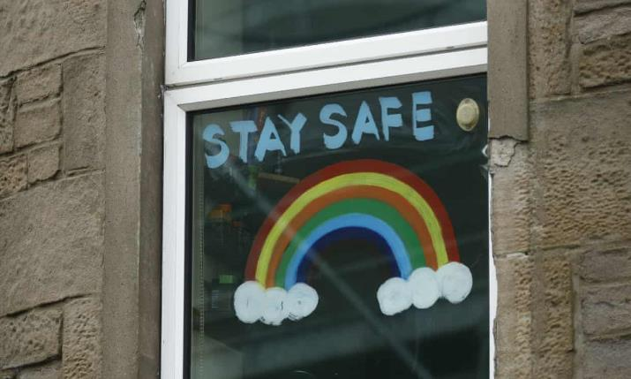
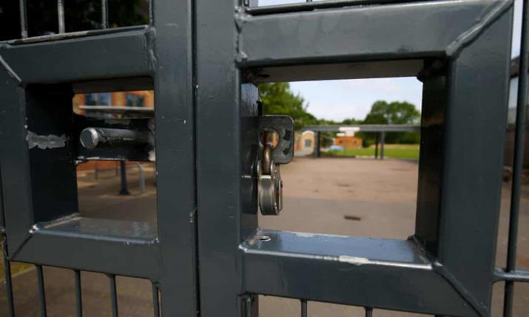
UK lockdown causing 'serious mental illness in first-time patients’
Psychiatrists say services could be overwhelmed by ‘tsunami’ of sickness triggered by crisis
The Guardian, 16th May 2020
School closures ‘will trigger UK child mental health crisis’
Expert adviser issues plea for major support, saying ‘we will have to pick up the pieces’
The Guardian, 20th June 2020

Slide 4
Adapting to our new ‘normal’
SOCIAL DISTANCING
New things for us all to come to terms with…
PANDEMIC
ANXIETY
PPE
TRAUMA
LOSS
FURLOUGHING
SHIELDING
BEREAVEMENT

Slide 5
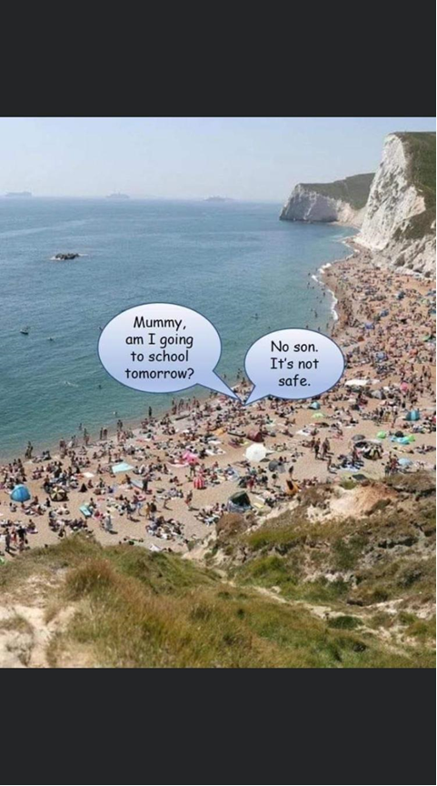
Managing uncertainty

Slide 6
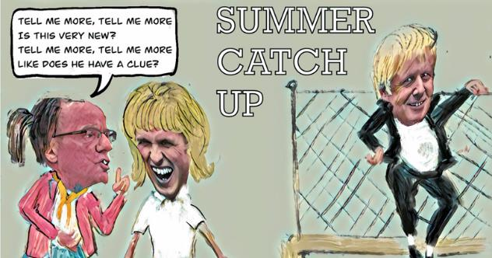
Education, Education, Education!
Schools shut abruptly in March
Some schools remain open for keyworkers’ children and vulnerable students
Most schools start to partially reopen for some year groups in June
Plans dropped for primary schools to fully reopen before the summer
Catch-up lessons over the summer
Schools in Anglesey to remain shut
Plans to fully reopen all schools in September
Leicester schools shut down again
Social distancing to be reduced from 2m to 1m +
Plans for September - staggered start and break times, smaller class sizes
Schools to have COVID-secure ‘bubbles’ - classes (primary) or year groups (secondary)
Whole bubble to be sent home if two or more students test positive

Slide 7
Wellbeing, Wellbeing, Wellbeing!
YP
STAFF
WHOLE SCHOOL

Slide 8
A tiered response: Universal and targeted
What schools already do and have to hand:
Access to support from Early Help
SEMH partnerships – peer problem-solving space
Designated staff acting as Wellbeing Champions
Young People working as Mental Health Ambassadors
Thrive practitioners
Nurture groups in some settings
Lots of schools have had training from the EPS on Emotion Coaching
Emotional Literacy Support Assistants – 73 schools now have an ELSA
Trailblazers – 23 Rotherham settings have Mental Health Support Teams (MHSTs) allocated
Trauma Informed approach – using the arts to help regulate and settle Young People. RoSIS have 4 practitioners and the EPS and Virtual school will soon have 4 EPs too who can help roll this practice out across Rotherham schools
RoSIS’ Daily Updates

Slide 9

A recovery curriculum
Reading
A Recovery Curriculum: Loss and Life for our children and schools post pandemic
Barry Carpenter, CBE, Professor of Mental Health in Education, Oxford Brookes University. Matthew Carpenter, Principal, Baxter College, Kidderminster, Worcestershire.
https://www.evidenceforlearning.net/recoverycurriculum/#mentalhealth
Listening
A Learning Shared podcast on the Recovery Curriculum
https://www.youtube.com/watch?v=Bvx0-mjT9Tc

Slide 10
…A relationships-based approach
Level 1 – Relationships
Level 2 – Community
Level 3 – Transparent Curriculum
Level 4 – Metacognition
Level 5 – Space
“Relationships: central to successful identification and support of children and young people.”
Dr Harriet Cameron, Prof Tom Billington, and Manel Lemmouchi, 2020.
CONNECTING
RELATING
REGULATING

Slide 11

Rotherham Educational Psychology
Service’s response
Emotional wellbeing check-ins for staff
Information for families on the Local Offer
Weekly video consultations available for parents/carers to book at RPCF’s Virtual Zoom Drop-in
Free online training modules
Live training to individual schools via an online platform upon request
Weekly mailshots to SENDCos
ELSAs – trained and supervised by EPS and working hard in schools across Rotherham over the course of lockdown
Critical incident guidance and support to schools
Portage Service – regular contact to all its families through whichever means preferred (phone, text or email). Families are being provided with resources and ideas to help the development of skills and the Facebook page also promotes activities for families

Slide 12


Rotherham Virtual School with the EPS
Transition Action Planning Tool - developed to support vulnerable pupils, including LAC, returning to school following lockdown. This has been circulated to all Designated Teachers (DTs). The plan highlights wellbeing, relationships and access to nurture/sensory provision
Supportive documents for Foster Carers - exploring anxiety and the use of positive psychology to focus on meeting the emotional needs of children and young people’s time whilst in lockdown. This guidance also promotes activities and ideas for structuring time spent at home to aid connection
Creative Mentoring - for those LAC who have a Creative Mentor, many have liaised on a regular basis through activity boxes, online chats and phone calls. In collaboration with Grimm and Co, Creative Mentors have also produced a YouTube channel https://www.youtube.com/channel/UCNY2MGTNewZ_kDY1LY7wT1A?view_as=subscriber Resources are shared on a Google Drive https://drive.google.com/drive/folders/140LPfTC-1-VVK_FeZYV_TX4iZiYQOyjF?usp=sharing

Slide 13

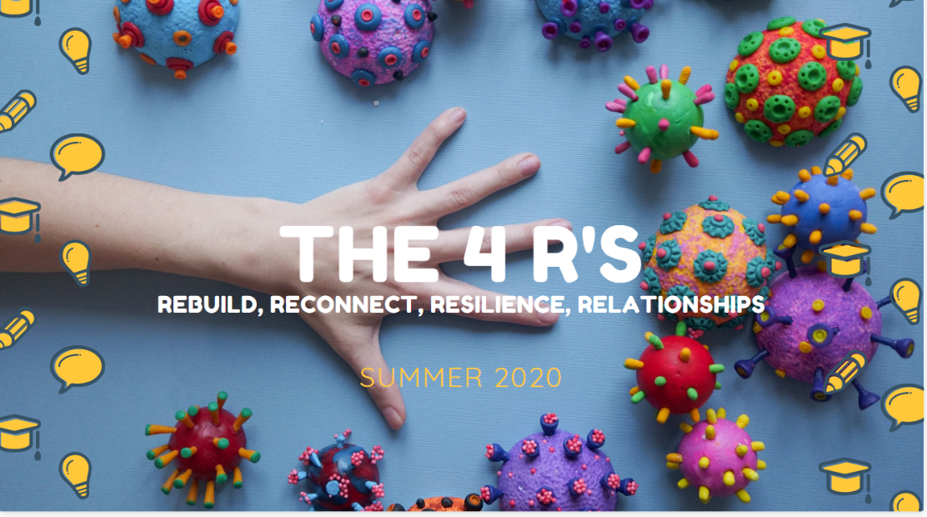

How are we supporting schools returning following COVID?
We are offering free resources to any school or academy irrespective of subscription status.
In this document you will find free resources linked to supporting children and adults back into school.

Slide 14
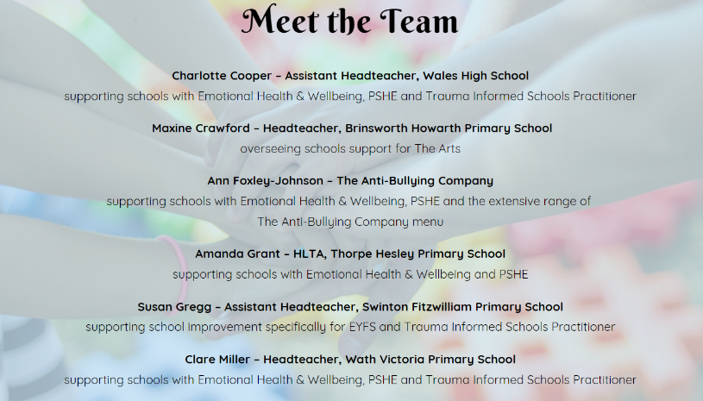
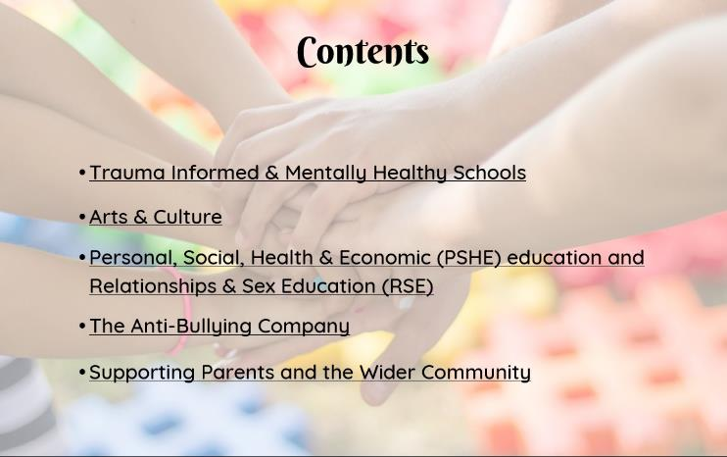

Each of these sections opens up into a description of the work and specific resources to support children and staff
There is also an appendix which links to a huge variety of other sources of support and help

Slide 15

Supporting a Borough-wide
Partnership Bid to the Arts Council
The 4 R's strategy is available free of charge to all schools, regardless of their buyback position with RoSIS. Within the document there are a range of additional services which can be purchased at an annual cost of £500. This package and financial contribution, will form part of a Borough-wide Partnership Investment bid to the Arts Council during the autumn term which is intended to attract and secure new sources of money not traditionally spent on arts and culture for children and young people.
This link will take you to the page which contains more information
https://weareive.org/ive-studio/bridge-organisations/partnership-investment/

Slide 16

Trailblazers: With Me In Mind (WMIM)
Regular consultation and guidance support
Website www.withmeinmind.co.uk (available to anyone)
Resources http://www.withmeinmind.co.uk/category/resources/
Series of videos around COVID and anxiety can be found either on website or YouTube (available to anyone). Advertised through parent newsletter https://www.youtube.com/playlist?list=PL2_RtUzQeufO2E-PzMIWjz6nHxaHKbxvf
Staff wellbeing forum available; contact senior practitioner
Staff training
Direct support for children and families; referral through consultation with senior practitioner

Slide 17



ROTHERHAM CAMHS
If you have concerns for a child / young person’s mental health in relation to COVID-19 we ask that you access the ‘Guide for Education Settings Supporting Children and Young People’s Mental Health and Emotional Wellbeing Needs as a Result of COVID-19’ (here).
We would also like to advise that Rotherham CAMHS Getting Advice Pathway are offering daily Consultation and Advice sessions which are available to pre-book. Please email rdash.camhsgettingadvice@nhs.net
(We will then take some details from you and arrange a time to discuss further).

Slide 18
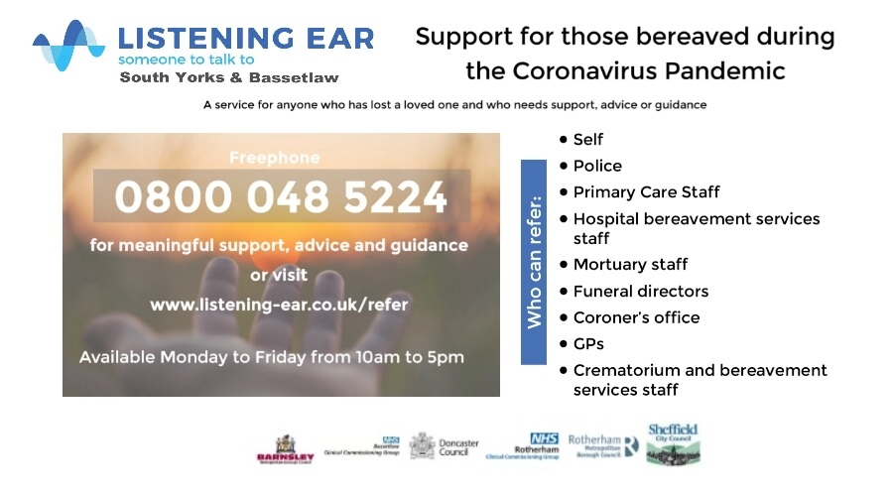

Employee Assistance Programme (EAP) – available to schools that Rotherham provides HR services to. The number for these schools to use is 0800 111 6387 or alternatively individuals can go online and register www.my-eap.com and use ROTHwell to log in

Slide 19
Other resources available
STUDENT WELLBEING
National Autistic Society https://www.autism.org.uk/services/helplines/coronavirus.aspx?gclid=EAIaIQobChMI5rPP47Kq6gIVU4BQBh0Rjg7VEAAYASADEgK5hPD_BwE
NHS Wellbeing planning tool https://learn.nes.nhs.scot/30741/psychosocial-mental-health-and-wellbeing-support/taking-care-of-myself/wellbeing-planning-tool
My Mind Matters http://www.mymindmatters.org.uk/
Young Minds https://youngminds.org.uk/
Y&H Children & Young People’s Mental Health Clinical Network - A Guide for Education Settings Supporting Children and Young People’s Mental Health and Emotional Wellbeing Needs Which Have Arisen from COVID-19 www.yhscn.nhs.uk/media/PDFs/children/Docs%20and%20Links/Guide%20for%20Education%20Settings%20Supporting%20CYP%20MH%20EWB%20-%20COVID-19%20FINAL%20v1.0.pdf
Healios: ThinkNinja https://www.healios.org.uk/services/thinkninja1

Slide 20
STAFF WELLBEING
Anna Freud – Looking after each other and ourselves: A guide to supporting the mental health and wellbeing of staff at schools and colleges during periods of disruption https://www.annafreud.org/media/11242/looking-after-each-other-ourselves-final
Anna Freud - Supporting staff wellbeing https://www.annafreud.org/what-we-do/schools-in-mind/resources-for-schools/supporting-staff-wellbeing-in-schools/
Anna Feud – Ten steps towards school staff wellbeing https://www.annafreud.org/what-we-do/schools-in-mind/resources-for-schools/ten-steps-towards-school-staff-wellbeing/
Mind https://www.mind.org.uk/information-support/coronavirus/coronavirus-and-your-wellbeing/
Mindkit 5 ways to wellbeing https://www.mindkit.org.uk/5-ways-to-wellbeing/
NHS 5 steps to mental wellbeing https://www.nhs.uk/conditions/stress-anxiety-depression/improve-mental-wellbeing/
NHS Every Mind Matters https://www.nhs.uk/oneyou/every-mind-matters/?WT.tsrc=Search&WT.mc_id=Brand&gclid=EAIaIQobChMI7q-Z7u2Z6gIVwoGyCh17EQLAEAAYASAAEgL-8PD_BwE
EVERYONE
Wellbeing resources from the Rotherham NHS Foundation Trust – support for everyone dealing with COVID-19 https://www.trftlibraryknowledge.com/coronavirus-health-wellbeing.html#everyone
Headspace app - https://www.headspace.com/covid-19

Slide 21
Training opportunities
EPS free online training modules - Training to support staff through the COVID-19 crisis: Bringing safety and hope https://www.rotherham.gov.uk/downloads/download/245/training-to-support-staff-through-the-covid-19-crisis-bringing-safety-and-hope
Winston’s Wish free bereavement training for teachers https://www.winstonswish.org/bereavement-training-courses-schools/
DfE webinars
- RSHE curriculum webinar: 7th July, targeted at school staff to help them deliver the new RSHE curriculum for pupils with SEND, including supporting their mental wellbeing.
Further information can be found here: https://registration.livegroup.co.uk/rshesend
- Supporting pupil and student mental wellbeing webinar: 9th July 10-11am, targeted at school and college staff to help them understand the impact of the pandemic on CYP MH and wellbeing and how they can support returning CYP.
For further information and to sign- up: https://www.eventbrite.co.uk/e/110796856380

