Slide 1



Trauma and Anxiety
Understanding and healing

Slide 2
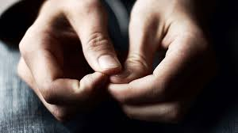
Aims
Helping you and staff to:
Understand key ideas and concepts within trauma and anxiety
Consider the impact on all young people as well as vulnerable groups
Reflect on a range of strategies and interventions
Remember that you are already skilled at relating to and communicating with children and young people.
This e-module is an opportunity to build confidence and further develop your skills.

Slide 3
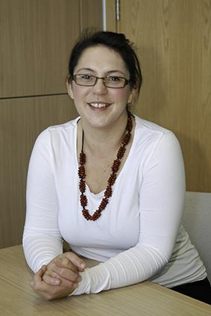
INTRODUCTION
Two truths and a lie – which is which?
I grew up in the Lake District
I finally passed my driving test on the fifth attempt
I have an allotment where I grow lots of fruits and vegetables
Find out later which is which…

Slide 4


Reflection
Reflect for a moment on your understanding, and perhaps your own experience, of trauma.
What experiences might lead to trauma?
How do people respond to trauma and what impact might this have?
What is different about a child’s experience of trauma and an adult’s experience of trauma?
These are some of the questions we will explore in more detail within this training session

Slide 5

What is Trauma?
‘When you lean against a wall…and the wall isn’t there’ Ester Perel
During difficult and distressing situations, children will look to the adults around them in order to understand and make sense of the unfolding events
If those adults are caring, understanding and supportive, then children are likely to cope and overcome, even from the most distressing of experiences
Sadly, this is not always the case for all, and some children may be left to make sense of the events on their own which may lead to misplaced blame and guilt. It may mean that thoughts, feelings and emotions are not fully resolved and processed which may lead to a sense of disconnection from people and even the world
Children who have already experienced trauma are at greater risk of complex and compounded trauma if they experience trauma again…

Slide 6
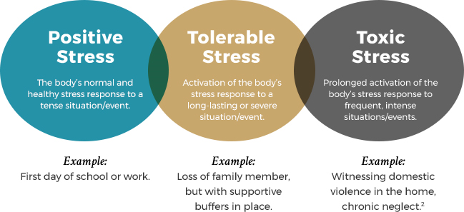
Stress and Anxiety
Stress is the direct/immediate response to an experience.
Anxiety is a persistent feeling of worry, fear or nervousness in response to a stressful event(s).
Key points:
All children, whatever age, experience powerful emotions including stress and anxiety
The world can be a frightening and uncertain place. Very young children and adolescents, who are facing a time of rapid physical and emotional change, may be more vulnerable in these situations
Powerful emotions affect all aspects of behaviour, wellbeing and cognitive processing
If these emotions are prolonged, they can affect all aspects of child development

Slide 7
How do children respond to trauma?
Trauma is common. Most young people will experience difficult and challenging events during their formative years. Everyone is affected by the current COVID-19 crisis, but individual experiences will vary dramatically.
Age and stage of development will have a significant impact on how young people make sense of their experiences.
Young people’s responses to trauma are complex and different to those of adults. Trauma may affect their development, including their sense of self, cognitive skills, emotional wellbeing, tolerance, moral development and ability to trust self and others.
Children who have experienced trauma may develop ‘survivor behaviours’. These help the child to survive extreme psychological stress in a hostile environment (i.e. fighting, running away, substance abuse, shutting down, self-harm, eating disorders…)
Even in a non-threatening environment, these behaviours may be displayed in order to deal with their ‘uncomfortableness’ and anxiety. To some children, even a nurturing environment may appear threatening.

Slide 8

The good news is, most children will cope with these experiences, and for some, there may be a positive effect sometimes called
‘post traumatic growth’.

Slide 9
Impact of trauma on children
Preschool age/stage children might:
Fear separation
Cry and scream
Lose appetite
Have nightmares
Use baby talk/play
Develop new fears
Constantly question
Re-enact trauma in play
Struggle to settle at night
Feel helpless and uncertain
Return to wetting and soiling
Primary age/stage children might:
Be easily upset
Cling to key adults
Share their trauma
Worry about safety
Feel guilt and shame
Struggle to concentrate
Expect repeat of trauma
Easily startled and upset
Become more anxious or fearful
Teenage age/stage might:
Feel different
Struggle with sleep
Report feeling numb
Use drugs and alcohol
Feel depressed and alone
Develop risk taking behaviours
Feel wound up and unsettled
Develop self-harming behaviours

Slide 10
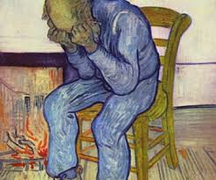
Signs someone may be struggling with trauma, after the immediate shock and fallout
Constantly reliving the trauma through repetitive play and conversation, frightening dreams, or new fears
Avoiding reminders of the event(s) such as people, places, activities and objects which bring back memories of the trauma
Having strong negative thoughts and moods such as fear, guilt, sadness, shame, or confusion and, alongside this, a loss of interest in activities that used to be enjoyed
Feeling wound up and pent up – having trouble sleeping or concentrating, feeling angry or irritable (or having temper tantrums), being easily startled, constantly on the look-out for danger and perhaps seeking danger
Isolating and withdrawing – from people and places which have previously been enjoyed and supportive
Samaritans Tel: 116 123
Website: www.samaritans.org
Childline Tel: 0800 1111
https://www.childline.org.uk/get-support/
NHS Tel: 111 or 999

Slide 11
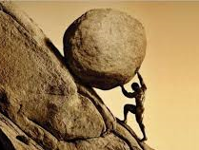

Trauma – What teachers need to know…
Please click on the link and watch the clip.
Learning Brain vs. Survival Brain
How can we make the stone smaller or make it easier to push?

Slide 12
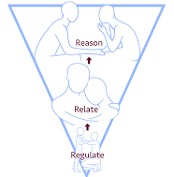
Trauma Informed Practice means:
Adults not only understand trauma, and the impact it may have on individuals, but they change and adapt to meet the needs of both children and staff in these situations.
Key points include:
Behaviour is a symptom of a problem, not the problem. This is not to say that violence or challenging behaviour are not addressed or have consequences, but that the response includes a depth of investigation, empathy and support
Children need to build their skills in order to overcome their barriers. Include them in the process
Connect with external agencies; no one can do this work alone
Respond to trauma, rather than react to trauma
Assume complexity, approach with empathy
Commit to building trust and relationships
https://beaconhouse.org.uk/wp-content/uploads/2019/09/The-Three-Rs.pdf

Slide 13
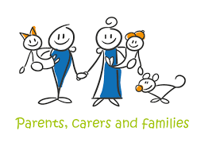
Working with parents and carers
Encourage the family to continue to enjoy activities
Keep offering reassurance; they are safe and cared for
Give the child special attention, especially at bedtime
Encourage the expression of emotions – they are part of the healing process
When they are ready, listen to and talk with the child about the trauma. Like adults, children can become frightened about things they don’t fully understand
Keep family roles clear. Don’t expect children to take on too much responsibility, but don’t become too overprotective either. Try to understand if they can’t do what is usually expected of them, like going to school. Reassure them it is okay. Talk about, and plan for, how they will get back to their normal routine as soon as possible

Slide 14

What can everyone do?
Encourage them to talk openly about their feelings. Try to understand if they have any worries or if they are experiencing any difficulties, e.g. “Is there anything about this that you’re especially worried about?”
Let them know that the event was not their fault, e.g. “Things like this can happen to anyone; it wasn’t your fault.”
Provide reassurance, e.g. “The important thing to remember is that you’re safe now.”…”Anytime you feel scared or upset about what happened, I’m here to help.”
Let them know that trauma is common and that it’s okay to be upset, e.g. “Sometimes things happen that are really scary, and it’s normal to feel afraid.”

Slide 15
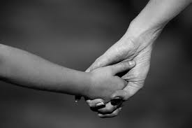
What can schools do?
Explain your role with the student
Establish yourself as a safe individual
Create an environment of trust and respect
Give the student opportunities to make choices
Teach positive self-talk, and practise it before you need it
Connect the student to the appropriate resources and people
Talk about safety and what steps you will take to help the student be and feel safe
Offer self-calming techniques, such as mindfulness, grounding, tracking, positive memories
Slow yourself down: talk slower, use a lower pitch for your voice and don’t use complex sentences
Use music, exercise, movement, stretching and incorporate more opportunities for humour and laughter in the curriculum (laughter reduces the traumatic response in the brain)

Slide 16
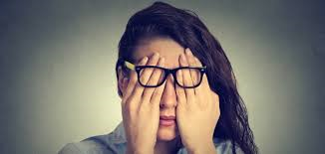
Preventing secondary or vicarious trauma
Secondary or vicarious traumatic stress is the emotional pressure that results when an individual hears, senses or experiences the first hand trauma of another person. Working with traumatised students can be overwhelming, so managing personal and professional stress is vital.
Trust that simple compassionate gestures are vitally important elements of helping young people in healing and surviving
Improving your understanding of trauma and secondary trauma will be beneficial
Recognise and accept that you may never see the outcomes of your efforts
Seek support from co-workers, family and friends
Recognise that change happens very slowly
Seek support from counselling services
Take time out to recharge
Know your limits

Slide 17
Positive Psychology: Post-traumatic growth
After experiencing a traumatic event, some people may report increased wellbeing. There are three ways in which their psychological functioning increases:
Relationships may be enhanced in some way. For example, people describe that they come to value their friends and family more, feel an increased sense of compassion for others and a longing for more intimate relationships.
People may change their views of themselves. For example, developing in wisdom, personal strength and gratitude, perhaps coupled with a greater acceptance of their vulnerabilities and limitations.
People can describe changes in their life philosophy. For example, finding a fresh appreciation for each new day and re-evaluating their understanding of what really matters in life, becoming less materialistic and more able to live in the present.
Given those ideas, if adults can model aspects of post-traumatic growth could children could feel the same?

Slide 18

Reflection
What strategies could you use to support all children and young people in your setting?
How can you support vulnerable children and families?
Do you have any more questions or would you like more information?
If you would like more information on Attachment and Trauma Informed Schools please contact either Rotherham Educational Psychology Service or Rotherham Virtual School.

Slide 19
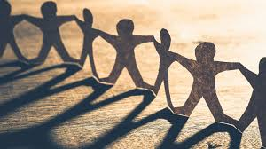
Final comment
“The more healthy relationships a child has, the more likely he will be to recover from trauma and thrive. Relationships are the agents of change and the most powerful therapy is human love. Relationships matter: the currency for systemic change was trust, and trust comes through forming healthy working relationships.”
(Dr Bruce Perry, PhD, MD, researcher and Child Psychiatrist, 2007)

Slide 20
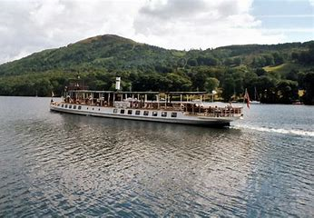
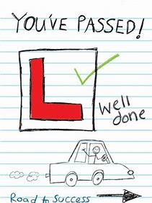
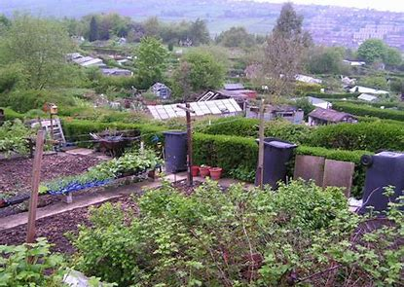
Two truths and a lie ???
I grew up in the Lake District
I finally passed my driving test on the fifth attempt
I have an allotment where I grow lots of fruits and vegetables

Slide 21
Further Reading and Resources
Websites:
Beacon House
https://beaconhouse.org.uk/resources/
Trauma Sensitive Schools
https://traumasensitiveschools.org/
Trauma Informed Schools
https://www.traumainformedschools.co.uk/
Scottish Attachment in Action
https://istss.org/home
Books on Trauma and Anxiety:
Perry, B., & Szalavitz, M. (2006) The boy who was raised as a dog: What traumatized children can teach us about love, loss, and healing. New York, NY: Basic Books.
Rossen, E., & Hull, R (Eds.) (2013). Supporting and educating traumatized students: A guide for school-based professionals. New York, NY: Oxford.
Hardy, K., V. & Laszloffy, T. A. (2005). Teens who hurt: Clinical interventions to break the cycle of adolescent violence. New York, NY: Guilford.
Geddes, H. (2006). Attachment in the classroom: The links between children’s early experience, emotional well-being and performance in school. Worth Pub.

