Slide 1
Fostering Resilience
Self-belief and connection

Slide 2
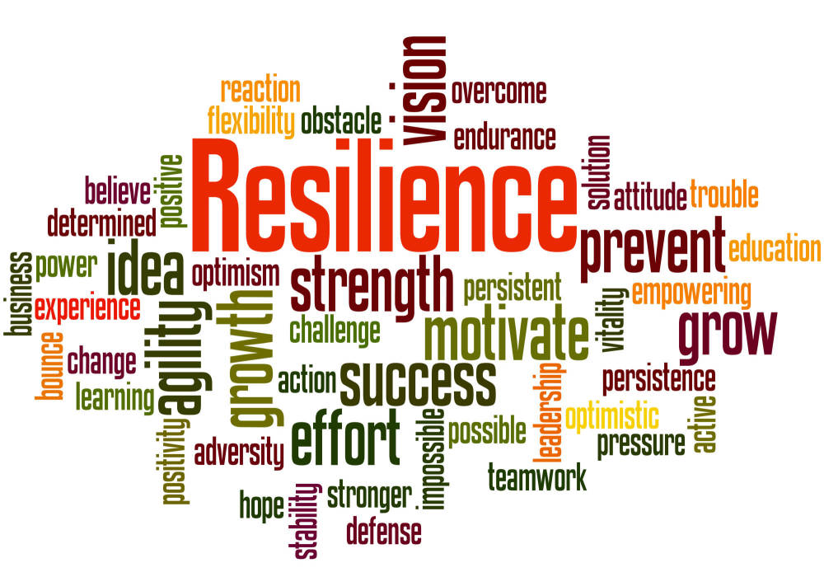
Aims
Reflect on our own views on resilience
Consider factors important to fostering resilience
Examine ways to support a sense of mastery
Explore how to support young people in developing connections with others

Slide 3
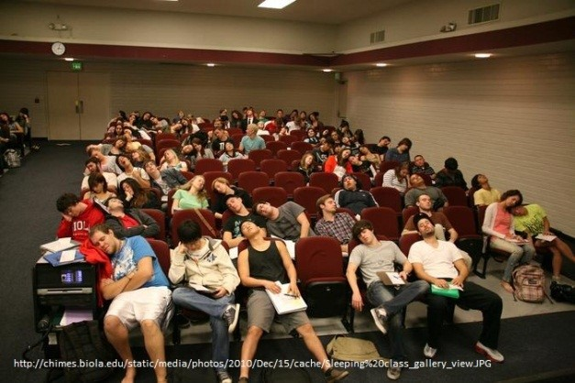
Introduction

Slide 4
Resilience…What does it mean to you?
Spend a brief period of time considering your thoughts about resilience…You might want to frame it in two questions:
What is resilience?
How is it developed?

Slide 5
Understanding the social context for resilience
Resilience is often defined as ‘…the process of, capacity for or outcome of successful adaptation despite challenging or threatening circumstances’ (Howard & Johnson, 2000)
However, resilience is not simply an innate capacity. Bernard and Slade (2009) highlight that resilience is supported by ‘turnaround teachers’ who can create nurturing and empowering climates. This in turn engages young people’s resilience by developing their capacities for positive development and school connectedness
Fostering resilience is a process that occurs largely in relationships

Slide 6
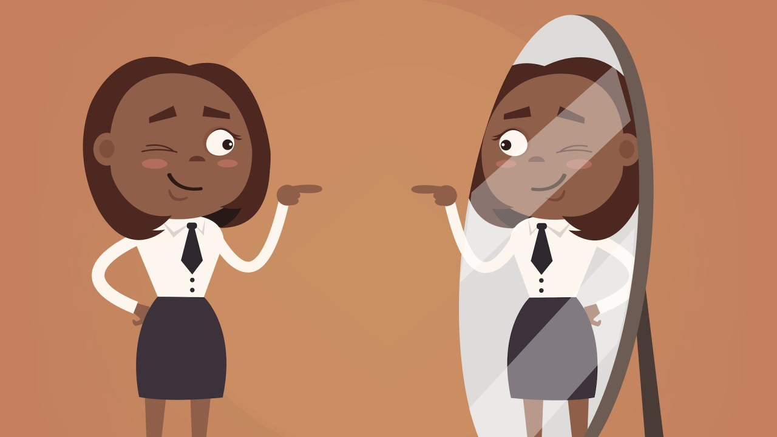
Indicators of resilience in young people (Grotberg, 1997)
A number of indicators of resilience are identified within the research including:
Having someone who loves you totally (unconditionally)
Having an older person outside the home you can talk to about problems and feelings
Having positive relationships with peers
Feeling that what you do makes a difference in how things turn out
Having a positive self-image
Recognising and using your strengths

Slide 7
What makes a difference (Sandra Prince-Embury 2012)
Sense of mastery
How optimistic we feel about the future
Whether we feel we can make a difference to the outcome of our own lives
Whether we feel able to see how we can adapt to new situations
Sense of relatedness
Whether we feel there are individuals we can trust
Whether we feel support is available to us when we need it
How comforting we feel support from others is
How easy we find it to move beyond incidents

Slide 8
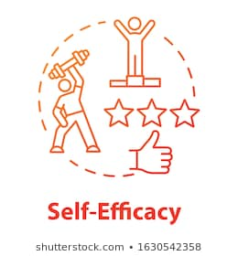
Supporting a sense of mastery
Adapting

Slide 9
Acceptance and Commitment
Bring ‘present’ in the moment
Being open to our thoughts and feelings
Accepting they are there
Attempting to limit being stuck in one thought (cognitive fusion)
Actively choosing what we do next in relation to what is important to us (our values)

Slide 10
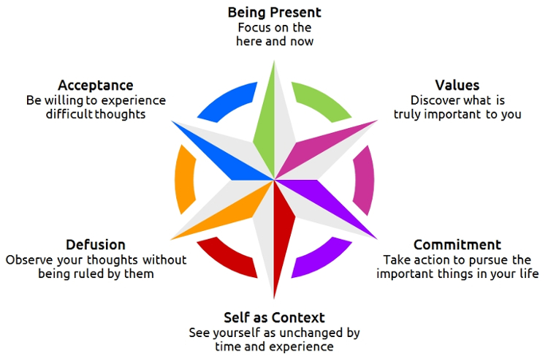
Acceptance and Commitment

Slide 11
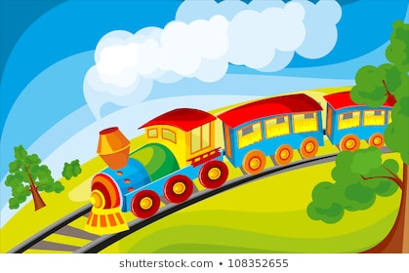
Train of thoughts
Sit in a relaxed position (eyes closed if you would like to)
Imagine yourself sitting outside on top of a large hill on a warm day
In the distance a train and all its carriages are passing in front of you. Imagine that each carriage represents a thought or feeling
Sometimes we find ourselves being drawn into one specific thought. We can imagine it as being drawn into one of the carriages
When that happens try and return to the hill, watching the train, our thoughts and feelings, coming and going
Reflect on your experience of following the mindfulness activity.
What did you find challenging about it?

Slide 13
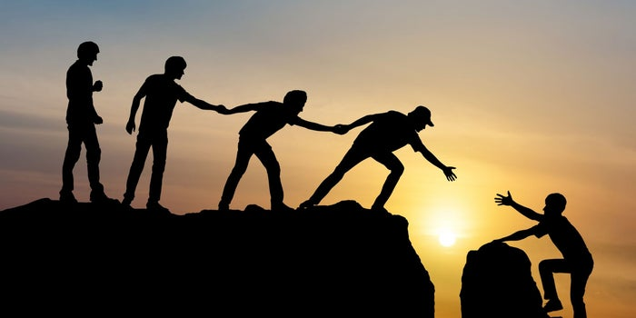
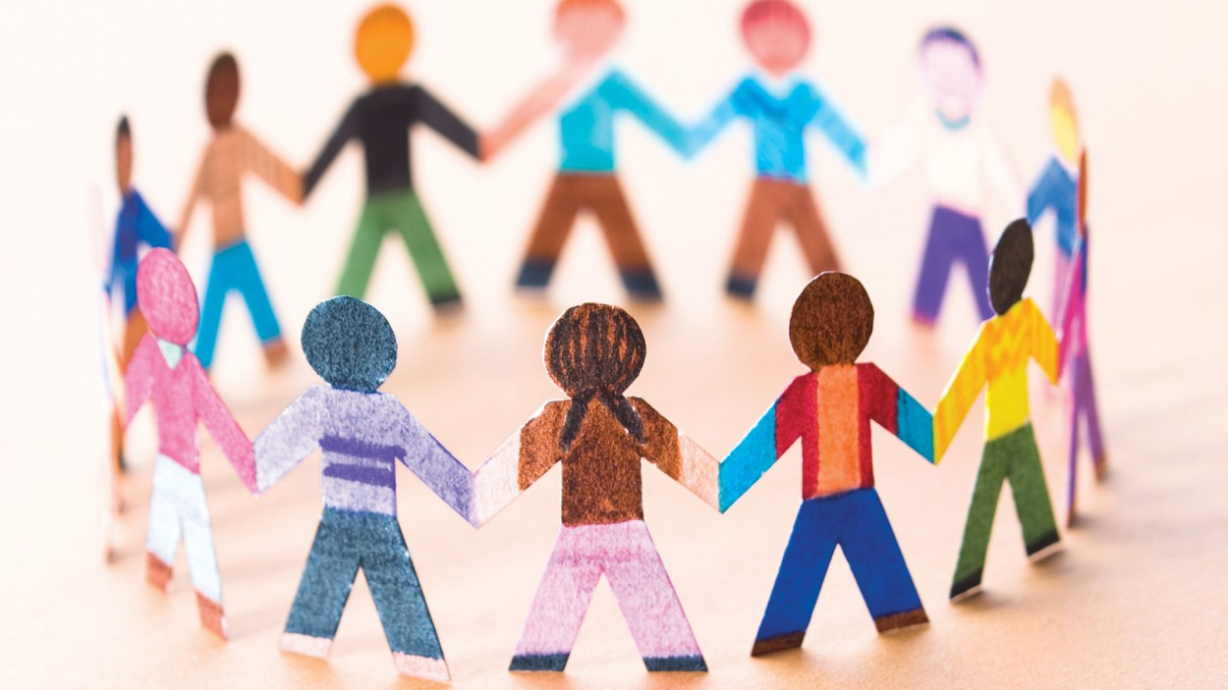
Supporting a sense of Relatedness
Trust
Comfort
Support

Slide 14
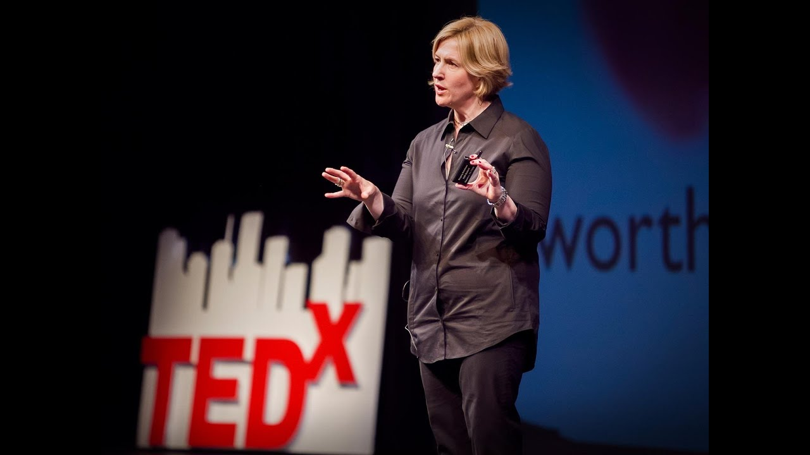
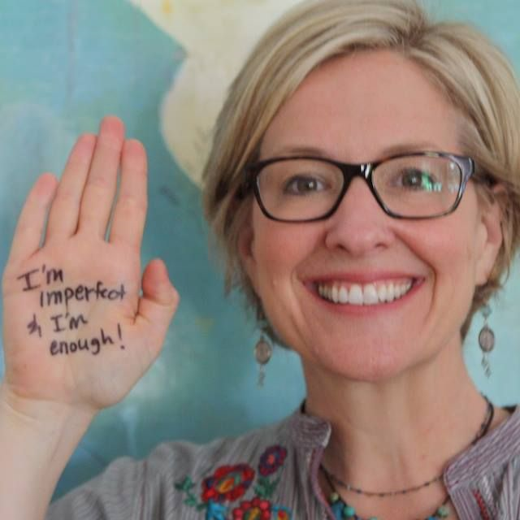
Vulnerability and connection
Feeling vulnerable is hard and we can want to protect ourselves from it
Feeling overwhelmed and anxious about something (even when other people are experiencing the same thing) can make us feel vulnerable and leave us unable to be ‘all in’ or to ‘armour up’
We can attempt to hide our vulnerably for all sorts of reasons. We may:
want to appear strong for others
not want to feel upset
not want to be seen as unable to manage when presented with other people’s emotions
not want others to see us as ‘emotional’ or perceive us as unable to cope
This can lead to disconnection

Slide 15
Vulnerability and connection
Fundamental to empathy is connection and this is what makes it hard. We can sometimes protect our own feelings, without even realising we are doing it, by pushing other people’s experiences away – if we can connect with it then we can feel vulnerable too
We need to feel safe to allow others to see our vulnerability
It will be important to think about how you engage with both your own sense of vulnerability and how you can help others to think about their vulnerability. Getting rid of vulnerability is not an option and only leads to disconnection. Take time to reflect on what challenges you might face.

Slide 16
How to promote connection
Having space to connect
Feeling safe
Building relationships
Understanding and showing empathy
Being creative, not always talking
Giving permission to express feelings
Reflecting on our own experience
Modelling accepting vulnerability for young people

Slide 17
Key messages
Resilience isn’t just something inside us, it comes from our interactions and environments
Supporting young people to feel able to make a difference in their own lives and feel connected to others is important
Learning to accept that we will have difficult thoughts and feelings is the first step in actively choosing what we do next
Feeling connected to adults and peers is fundamental for enabling resilience
When we feel vulnerable it can be hard to build relationships with others
We have to give time and space to have shared experiences and model for young people how to cope with these difficult feelings
Notes:
Resilience is something we can help to foster in young people, it is not something they just have for themselves.
Some young people will feel vulnerable and out of control
Supporting them feel they have some mastery over their lives and feel connected to others will help
Helping young people learn to accept that they will have difficult thoughts and feelings can help them to begin to take control back of their lives rather than being ruled by their emotions
Mindfulness techniques can help train young people (and us) to become better at not becoming fused with one worrying thought
We can then begin actively choosing what we do next
Feeling connected to our adults and peers is a distinct indicator for reliance

Slide 18
Further Reading and Resources
Bernard, B. (2004). Resiliency. What we have learned. San Francisco: Wested.
Bernard, B. & Slade, S. (2009). Listening to students: Moving from resilience research to youth development practice and school connectedness.
Brown, B. (2015). Daring greatly: How the courage to be vulnerable transforms the way we live, love, parent, and lead. Penguin.Grotberg, E. (1997). The international resilience project. A charge against society: the child's right to protection, 19-32.
Prince-Embury, S. (2013) Resiliency Scales for Children and Adolescents: Theory, Research, and Clinical Application. In: Prince-Embury S., Saklofske D. (eds) Resilience in Children, Adolescents, and Adults. The Springer Series on Human Exceptionality. Springer, New York, NY.
Brené Brown talks:
https://www.youtube.com/watch?v=_UoMXF73j0c
https://www.youtube.com/watch?v=X4Qm9cGRub0
https://www.youtube.com/watch?v=DVD8YRgA-ck
60 Mindful Minutes – not the activities but some information on the resource
https://www.nurtureuk.org/sites/default/files/60_mindful_moments_booklet-web1.pdf

