Slide 1



Being AN Emotionally Responsive setting or team
Creating a supportive climate

Slide 2
Aims
Show the importance for leaders and other staff of trying to establish an emotionally responsive culture
Identify the different factors involved
Consider psychologically based models that might be helpful
Suggest practical steps individuals and teams might take
Reflect on the benefits for your whole community

Slide 3
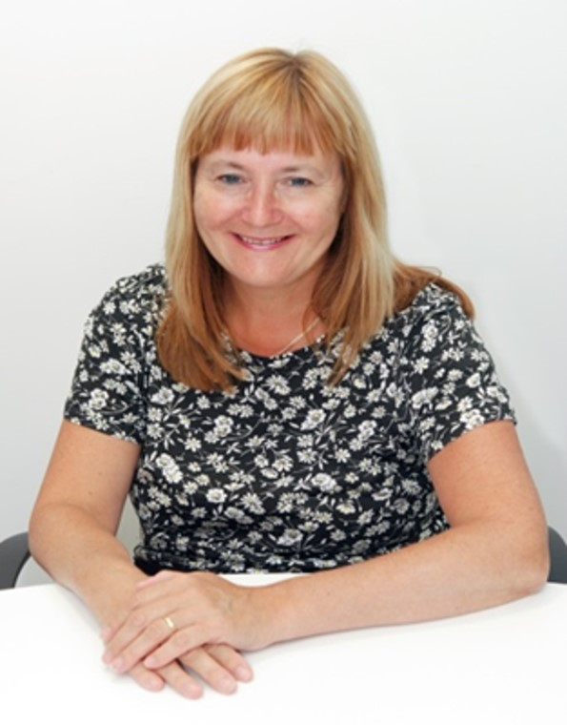
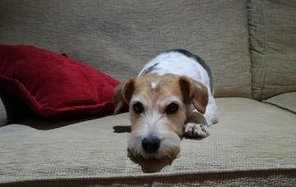
Introduction

Slide 4
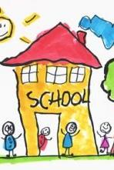
What creates culture and ethos (climate)?
Anything that connects the community, supports a feeling of belonging, forges identity and enables positive relationships, for example shared:
Values
Expectations (social norms)
Language
Communication systems
Symbols, uniform, badges and other objects
Traditions, practices and routines
There is plenty of evidence that settings and teams investing in creating whole school ‘cultures and structures’ are more likely to promote emotional wellbeing and good mental health.

Slide 5




Why a whole school, setting or team response is so important

Slide 6
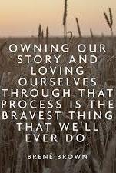

What is our story?
Who are we as a setting or team?
How do we respond?
How do we recover?

Slide 7
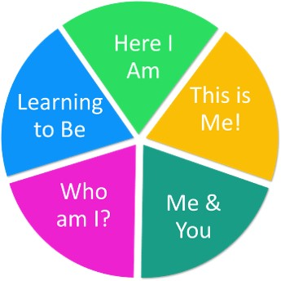
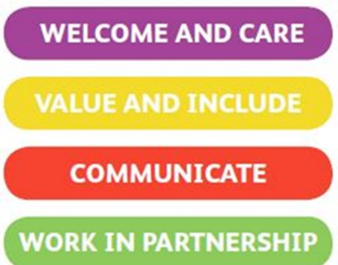
Useful Rotherham models
REFLECT
The Four Cornerstones (Rotherham Charter)

Slide 8

Some of the psychology behind these models
Developmental
  Thinking about emotional growth in milestones or stages
Attachment theory
  Focusing on relationships and the influence of psychosocial processes occurring between early caregivers, babies and children
  Trauma informed practice
Social constructionism
  Taking account of ecological perspectives and systemic thinking, emphasising the relationships and interactions between people
  Dynamic rather than linear
  Generating the capacity for people and organisations to reconstruct potentially difficult experiences by drawing on strengths and encouraging the creation of new stories with hope

Slide 9
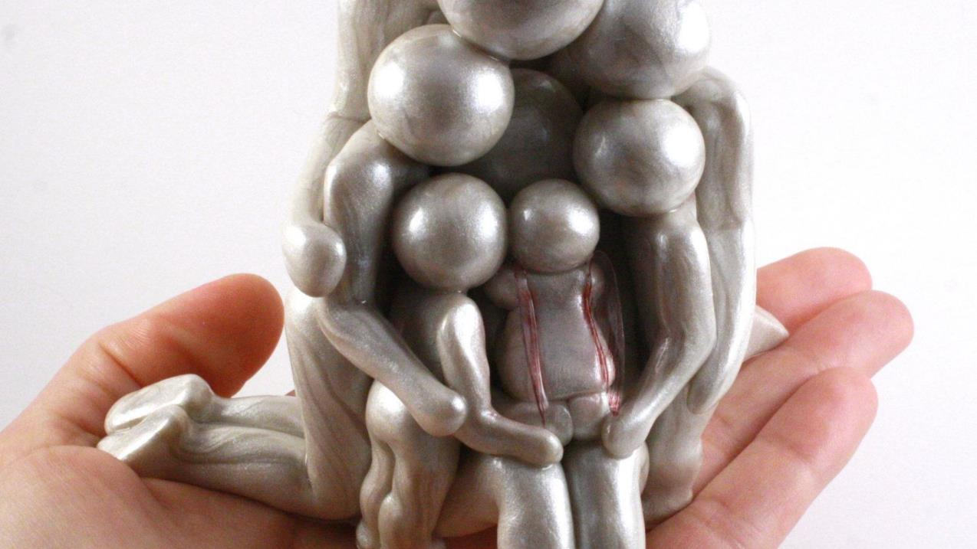
Stephen Hyman (2012) talks about schools as ‘holding environments’ for strong emotions, fostering the natural development of each child, bolstering security so that learning can take place
Experiencing the world as predictable and organised brings security and helps everybody feel more in control even when there is change and uncertainty
Learning will be profoundly influenced by relationships with individual staff and leaders, as their actions will be a model for others to adopt and internalise (Heather Geddes, 2006)
To create this culture adults need to be empathetically attuned to the needs of others in their care
To be available rather than preoccupied, it is important to pay attention to what is happening for ourselves, otherwise it will be harder for children, young people, parents and carers, and staff, to feel safe, reassured and able to regulate their own emotions
In this model, less helpful ways of relating to others might be seen as defence-mechanism patterns that have built up to ward off anxiety that could otherwise feel overwhelming
How decisions are made about achieving this way of responding during the challenges introduced for settings and teams by COVID-19 will be as important as the decisions themselves

Slide 10
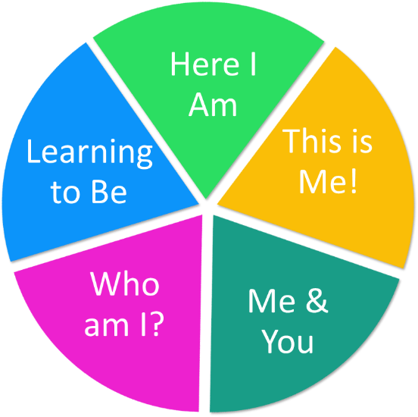
REFLECT
Five phases
Flexible and interactive rather than linear
Does not expect any individual child, young person or adult to respond in the same way to events and circumstances
Takes account of formative and current experiences
Indicates why we may all have to ‘re-visit’ phases
Describes our priority needs at these times
Provides suggestions about how others could respond

Slide 11
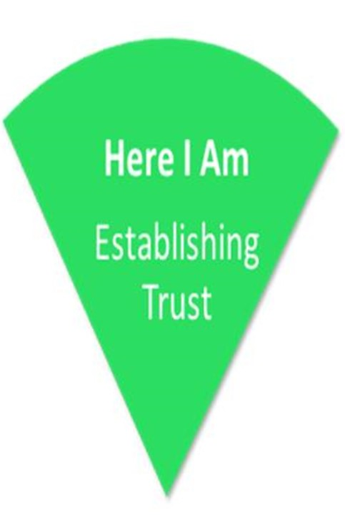
Here I Am
Establishing Trust
I need to:
Feel special
Feel content
Feel calm
Feel safe
Feel secure
Feel settled
Feel rested
Feel comforted
Feel regulated
Feel cared for
Learn to trust

Slide 12

Strategies to consider
Involving all partners in working out how best to respond
Building positive, consistent links between environments
Using familiar items, or images, and language
Setting up a predictable, consistent routine, as far as possible
Using developmentally appropriate visual timetables
Adopting a key adult approach, providing familiarity and dependability
Providing a ‘safe base’ where individuals can feel secure
Ensuring promises made are kept
Encouraging and developing activities requiring joint attention
Ensuring success and providing praise for progress and achievements
Providing a safe environment in which to communicate emotions
Allowing time to become familiar with new adults/routines

Slide 13

This is me!
Exploring the world
I need to:
Begin to share my experiences with others
Be curious and show interest in new experiences
Get things wrong, make a mess and use my physical skills
Occupy myself with self-chosen activities as well as follow instructions from others
Explore the world around me, safely and with consideration
Play with others; seek out opportunities, offer ideas or suggestions
Make simple choices
Manage my feelings
Recognise and communicate my likes and dislikes
Recognise and know how to talk about different feelings
Concentrate on tasks and be able to keep focused for short periods
Take my turn and manage waiting
Have a sense of my body limits, body shape and size and be aware of others when I am active

Slide 14
Strategies to consider
Creating a rich, imaginative environment
Using the language of emotion; naming feelings and actions
Attuning to individual’s experiences and wellbeing – ‘be with them’
Giving limited choices and options
Encouraging participation in making choices
Enabling personal interests
Allowing enough time for activities and keeping a (photographic) record which can be referred to
Having clear rules that are discussed and applied consistently
Playing games that promote co-operation and turn taking

Slide 15

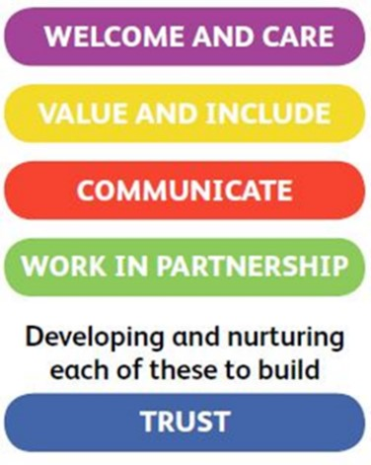
The Four Cornerstones (Rotherham Charter)
How can we make the Cornerstones a continued reality in the experience of all our staff, children and young people, parents and carers during this crisis?
What are we already doing?
What might we do better?
How might we involve all our partners in thinking about this?

Slide 16

Why wellbeing, inclusion and co-production are more important than ever
We will need different routines
What about social distancing?
How do we protect vulnerable children and young people, families and staff?
There will be varying emotional responses
Trauma
End of key stage transitions
How can we deliver the curriculum?
I feel out of control...

Slide 17




It is important to be able to voice our feelings
We want to listen and respond with empathy
These changes make it a transition for all of us
Let’s invest in preparation, do what we can, when we can
Build upon the great work you have already been doing during the lockdown
Be creative to help re-establish relationships and set up networks
Make reasonable endeavours in partnership
Develop personalised and group arrangements – don’t expect the same things to work for everybody!

Slide 18
We will not always get it right but we will try our best
Work out different forms of communication
Deliver an accessible curriculum with imagination
Continue to be playful, generate humour and make smiles
Take into account emotional and developmental needs including ‘re-visiting’
Promote our core values and sense of belonging
Generate a community ethos
Bring growth, hope and healing

Slide 19
What is our story?
Who are we as a setting or team?
How do we respond?
How do we recover?

Slide 20
Further Reading and Resources
https://www.annafreud.org/media/11610/managing-unexpected-endings-transitions-may2020.pdf
EHC needs assessments and plans: guidance on temporary legislative changes relating to coronavirus (COVID-19)
Geddes, H. (2006). Attachment in the classroom: The links between children’s early emotional wellbeing and performance in school. Worth Publishing, London.
Genuine Partnerships (2020 – 2nd Ed.). The Four Cornerstones Approach to Co-production, Strengthening inclusive practice, emotional health and wellbeing within your ethos and culture, genuine.partnerships@rotherham.gov.uk
Hyman, S. (2012). The School as a Holding Environment, Journal of Infant, Child, and Adolescent Psychotherapy, 11, 3, 205-216.
Rotherham Educational Psychology Service (latest version 2020), REFLECT, EPS@rotherham.gov.uk
Stirling, S. and Emery, H. (2016) A whole school framework for emotional well-being and mental health: supporting resources for school leaders, National Children’s Bureau (NCB), London

