Slide 1



Staff wellbeing
Looking after yourself
Notes:
Add symbols throughout if agreed

Slide 2
Aims
To appreciate the possible risk factors that can affect our wellbeing
To allow ourselves time to reflect on lockdown and the impact that the situation may have had, and be having, on our wellbeing
To identify and promote the protective factors we have around us
To begin to think about how we can best move forwards

Slide 3
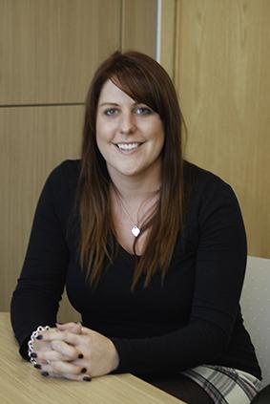
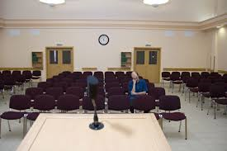
Introduction

Slide 4
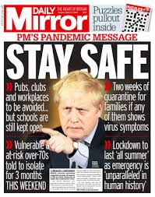




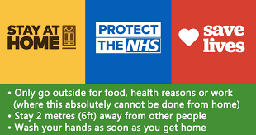
What are we faced with?

Slide 5

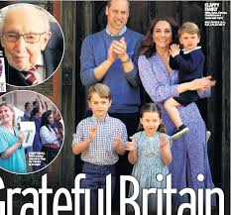
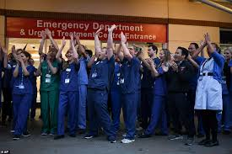




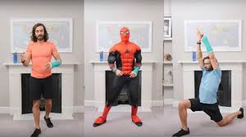
Uniting a Nation

Slide 6

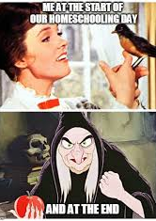

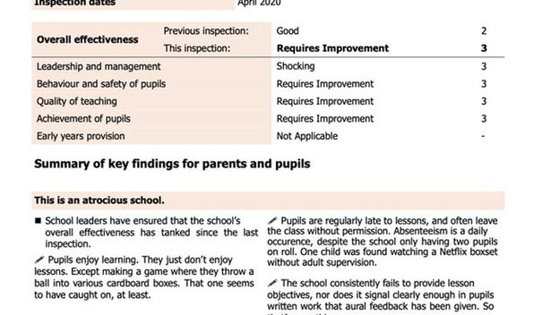

Home Schooling
As a teacher home schooling should be a breeze, shouldn’t it? After all, you usually have to manage a class of 20+!!!
Thanks to the powers of modern technology there have been a variety of mediums schools have been able to use to keep in touch with their pupils.
Nevertheless, there are still many challenges.
Like this one maybe?

Slide 7
How have recent events affected you?
One Perspective | Another Perspective
Spending quality time with your nearest and dearest | Being stuck in the house with the same people indefinitely
Sharing your children's learning journeys with them | What are they even teaching nowadays? This is not the same as when I learnt it
Gaining time you would never have got at home as your place of work has closed | Being worried that your bills and expenses will not be covered
Using social media to keep in touch with friends and family | Feeling sad that the only contact you can have with friends and extended family is through a device
Home schooling your children and watching them learn and develop | Battling with your children to do school work when they are at home
Learning a new language, skill, exercise routine | Getting annoyed with yourself because today you have managed to clean, dress and feed everyone and nothing else
Living alone and enjoying the time to embrace your interests and hobbies | Feeling lonely and isolated

Slide 8
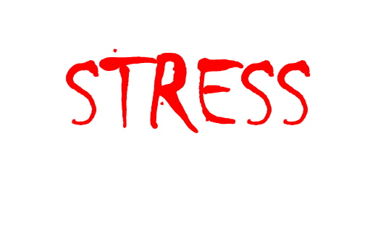
Mental Health
Everybody has mental health, just like we all have physical health. Most of the time our mental health is okay, sometimes our mental health is good, or even brilliant. But sometimes it’s poor…and that is okay
How we perceive, respond to, and manage stressors is affected by our mental health
Experiencing a lot of stress at once (trauma) or over a sustained period of time can affect our mental health
So, in the current climate it would be more than understandable if we were not ‘tip top’ on the mental health front
Good mental health = positive ‘emotional health’ or ‘wellbeing’

Slide 9


Wellbeing…
What does it even mean?
Watch this short video and think about what Wellbeing means to you

Slide 10
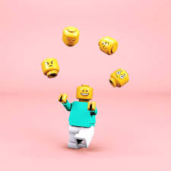
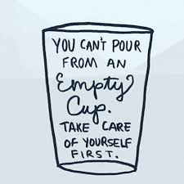

Looking after yourself
We have to allow ourselves time to look after our own mental health in order to be able to support and look after others
Juggling life can be challenging, add in the current situation of uncertainty, and the unknown may leave us feeling a little lost
We all have risk factors and protective factors. We need to think about what these may be for us and what we can do to look ourselves
What do you think your current risk factors are?

Slide 11
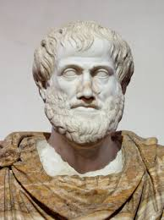
A bit of philosophy
The Greek philosopher Aristotle (300BC) thought you needed to feel good and flourish in order to achieve true happiness.
Take some time to think about what do you do to make yourself feel good.

Slide 12
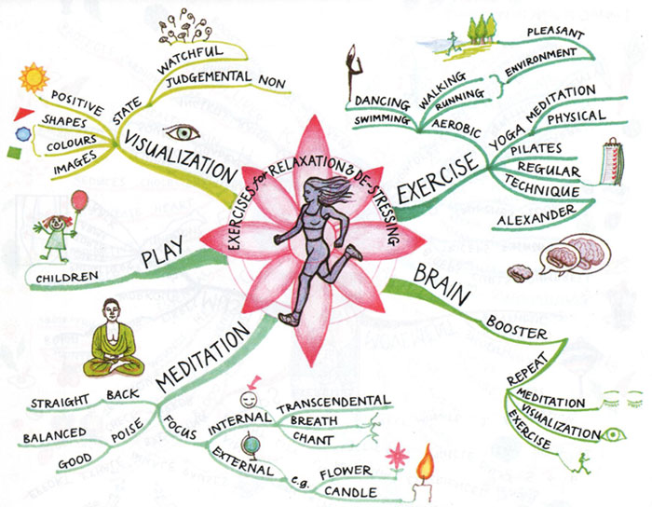
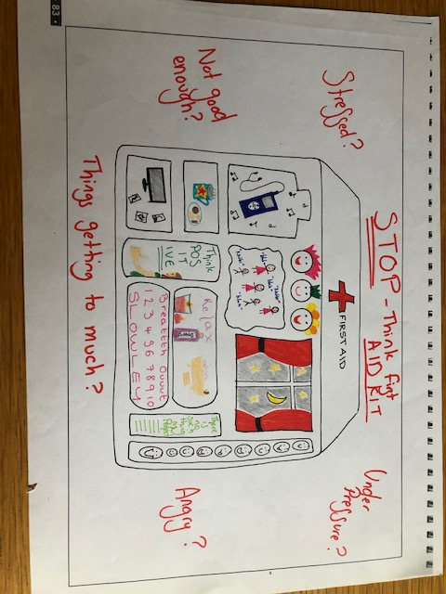




Things that help
Try this 20 minute Guided Meditation
Close your eyes and listen to a calming piece of music
Practice some deep breathing
Do an online exercise class

Slide 13
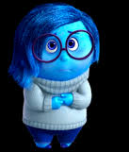
When Sadness takes over

Slide 14
Moving forwards
Consider what you have control over; feeling out of control can increase our stress levels. Try and focus on the areas of your life that you have control over
Take breaks from the news and social media
Do not compare yourself to others; it doesn’t matter what Sandra at number 23 has done or whether @lovingthemumlife has redecorated every room in the house, whilst baking daily and ensuring her 6 children have completed all of their school work each day. Remember that social media posts are RARELY a true reflection of real life
Share how you are feeling with others around you

Slide 15
Moving forwards
Focus on what is working – the positives that are happening for you right now: these are your protective factors. Try reframing negative thoughts that may creep in
Remember it’s okay not to feel okay. When you feel this way, try out one of the strategies you have identified that help you to feel happy/relaxed/refreshed
Try and allow yourself to be comfortable with the uncomfortable…we don’t know what the ‘new normal’ will be. It’s okay not to have all the answers

Slide 16
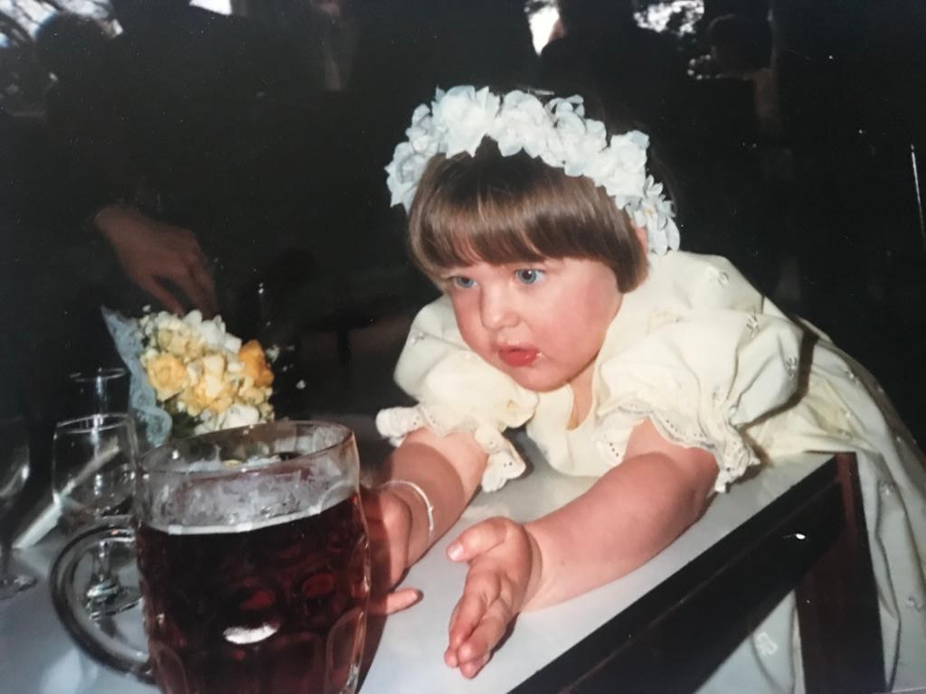
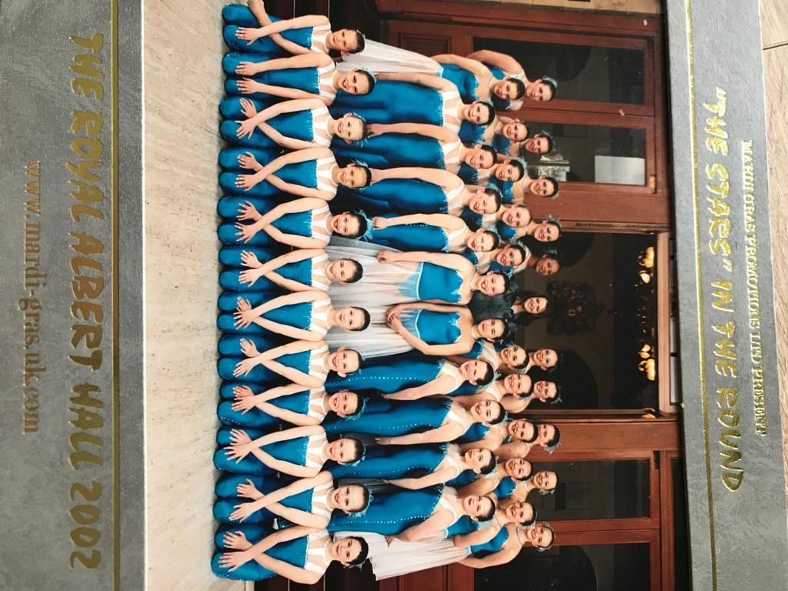
Two Truths and a Lie

Slide 17
Further Reading and Resources
www.mind.org.uk
NHS Websites including Every Mind Matters
Harris, R (2009) ACT Made Simple: An Easy-to-read Primer on Acceptance and Commitment
Explore Podcasts: Happy Place, Unlocking Us, The Happiness Lab for example
YouTube has lots of Guided meditation videos – Top tip: find a voice you can listen to
Try out mindfulness Apps like HeadSpace and Calm. Both have free elements/trial offers
The book that you have been putting off reading since the autumn term!

