Slide 1



Promoting positive transitions to school
Planning for young people and staff
returning to school

Slide 2
Aims
To consider the issues that might impact on young people and staff as they return to school
To hear the voice of young people
To explore how we can promote positive transitions for staff, young people and parents

Slide 3
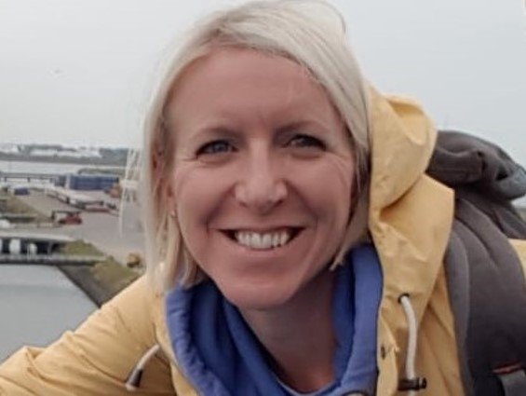


Introduction
Rotherham Educational Psychology Service
Rotherham Virtual School

Slide 4

Same Storm; Different Boats

Slide 5

Why is transition important?
Change is a normal part of life
Transition is a process not an event
Experiences of transition have powerful and long-lasting effects on academic outcomes, self-esteem and emotional wellbeing
Transition can be exciting
It can also be accompanied by experiences of loss and worries
  Loss of attachment to familiar people and environments
  Role and identity uncertainty
  Entry into a less predictable environment
  Perceived loss of control
  A feeling of being de-skilled and less valued

Slide 6

Prioritise emotional wellbeing and mental health
Rapid Systematic Review: The impact of social isolation and loneliness on the mental health of children and adolescents in the context of COVID-19
(Loades et al., 2020)
Key findings:
a clear association between loneliness and mental health problems in children and young people
loneliness predicted mental health problems up to nine years later
that children and young people in enforced isolation or quarantine were five times more likely to require mental health service input after previous pandemics

Slide 7

Voice of young people
WORRY ABOUT OWN AND FAMILY SAFETY
“Not catching the virus and having hand sanitiser and washing facilities. I worry about bringing the virus home to my mum”
What is important to you?
LEARNING
“Can there be extra lessons to catch up on learning?”
RELATIONSHIPS WITH FRIENDS AND TEACHERS
“I’m excited to be going back to school”; “Seeing my mates”
NEW YEAR GROUPS AND MAJOR TRANSITIONS
“Tour of college before
I go”
TIME TO LEARN ABOUT AND PREPARE FOR ROUTINES
“I am not sure if I need the 2 metre gap or not to stay safe in my classroom”
EMOTIONAL NEEDS
“When I go back I will be agitated and I will need some extra support, I am quite emotional”
BASIC NEEDS BEING MET
“The canteen and refreshments bars at college need to be open for students”

Slide 8
STARTING BACK: Will everyone start back? | SUPPORT: Who will support me? (particularly around managing difficult emotions | KEEPING SAFE: How will I be protected? | WHEN & HOW: When will things change and how? | CATCHING UP WITH WORK: Will I have work to catch up on? | SEEING FRIENDS: Are we going to be able to see our friends?
Could the school timetable be staggered so that we are not all in the corridors at the same time? | How people have been feeling in the lockdown and who can help them if they are feeling sad | How can I keep safe at school when I go back to school? | When will this be happening? When will I be going back? | How will we catch up with work? | Are we going to be able to sit next to each other?
Will we go back full time? | Will the teachers talk to us about the virus if we feel sad or upset? | Are we going to have to wear masks or carry hand sanitiser? | Will I be going back before I leave, and if so when? | Are we going to restart our topics again or can we just carry on from where we were? | Are we going to be able to see our friends?

Slide 9

So what should we do?
Reflection
Take a moment to consider…
What would help you settle back to work?

Slide 10
So what should we do?
Five principles:
A Sense of Safety
A Sense of Calm
A Sense of Self and Collective Efficacy
Social Connectedness
Promoting Hope
With thanks and acknowledgement to Northamptonshire Educational Psychology Service - Promoting Positive Transitions during and after the COVID-19 crisis: Guidance on supporting children and young people to start or return to school.

Slide 11
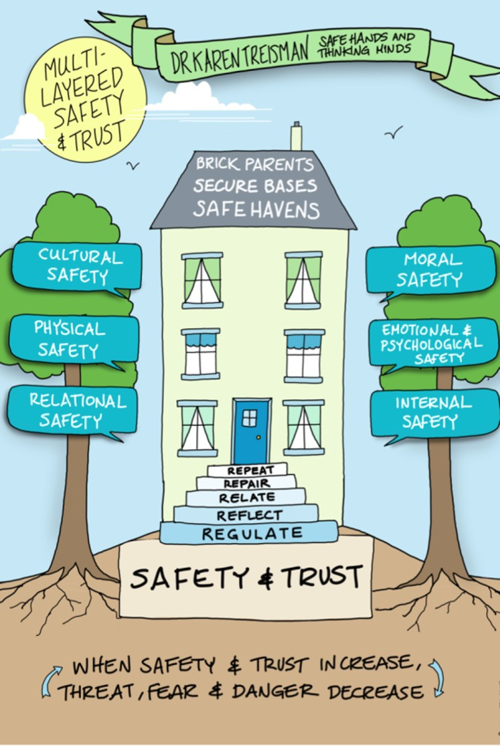
1. A Sense of Safety
Start with staff
Structure and routine
Boundaries with kindness and compassion
Physical safety
Transitional objects
Safe spaces to talk
Watch with curiosity and empathy

Slide 12

2. A Sense of Calm
Consider what children will need before they even enter the building
  How will the school look? How will the classrooms look? Who will be supporting them? How can virtual reconnection be achieved?
  What message do we want our school to give? “We look forward to seeing you”…“Our priority is to keep you safe”
Consider what is required when children return
  Warm welcomes
  Calm corners
  Mindfulness , yoga and meditation
  Frequent check-ins

Slide 13
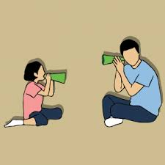
3. A Sense of Self and Collective Efficacy
Obtain the voice of children and young people
Create a sense of community in your school and classrooms
Responsibilities – jobs/tasks
Teaching problem-solving skills

Slide 14

4. Social Connectedness
“Every interaction is an intervention.”
(Dr Karen Treisman, 2017)
We need to create meaningful experiences of social connectedness:
Peer mentoring/Buddy systems
Circle time/tutor periods
Build relationships/reconnect
Key adults
Be deliberate, sensitive and persistent.
“The more healthy relationships a child has, the more likely he will be to recover from trauma and thrive. Relationships are the agents of change and the most powerful therapy is human love.” (Dr Bruce Perry, 2007)

Slide 15
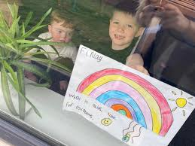


5. Promoting Hope
Hope helps pupils hold on to the possibility of change and the anticipation and wish that tomorrow will be better. When hope is present it can make the most difficult challenges feel manageable and survivable.

Slide 16
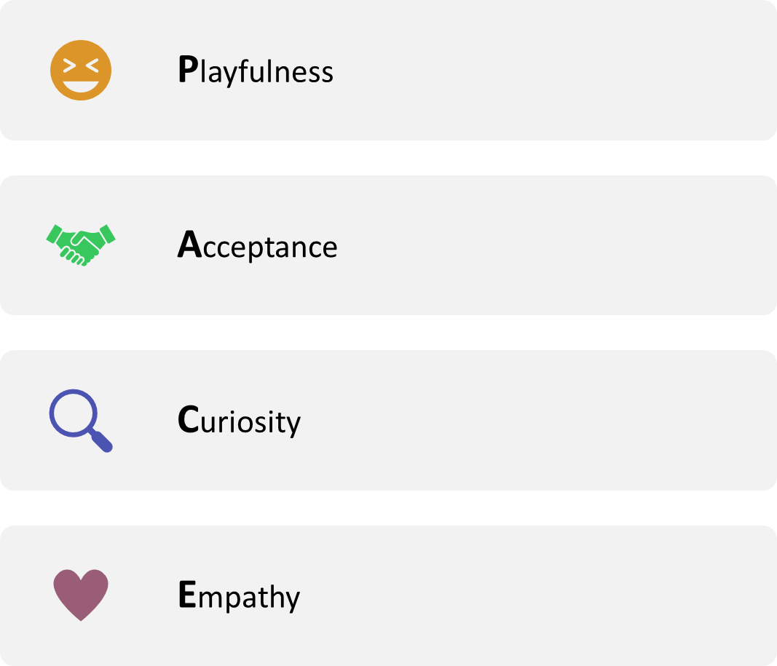

Play
PACE: Daniel Hughes
Resource: Poster to illustrate PACE

Slide 17

Learning
Brain prioritises need for survival and sense of safety over higher order skills needs for learning.
(Cozolino, 2015)

Slide 18
Further Reading and Resources
Acknowledgements & References:
Hobfoll, S. E. (2007) Five essential elements of immediate and mid-term mass trauma intervention: Empirical evidence. Psychiatry, 70 (4) 283-369
Loades, M et al (2020) Rapid Systematic Review: The impact of social isolation and loneliness on the mental health of children and adolescents in the context of COVID-19 https://osf.io/qh5fp/
Promoting Positive Transitions during and after the COVID-19 crisis: Guidance on supporting children and young people to start or return to school. Northamptonshire Educational Psychology Service
https://marymered.wordpress.com/
Resources:
Barry Carpenter’s Recovery Curriculum
Free mindfulness app and resources – for adults or young people: https://www.smilingmind.com.au/
Calming breathing and stretching exercises for children based on yoga
Social Stories
The Three Rs Reaching the Learning Brain
Young Minds Hope Clouds Activity
PACE poster

Slide 19
Feedback
This is the first time we have delivered training in this way. It has been a learning curve for all of us! It would be really helpful to know what you think. If, upon completion of the course, you would be good enough to share your views with us, we would be extremely grateful. This will not only help us improve training of this nature but also assist us in planning future online training as we all try to adapt to the ‘new normal’.
If you would like further information about the content of any of the modules, or you have views about the course modules and design, please e-mail EPS@rotherham.gov.uk
We hope you enjoyed the course!

