Slide 1
Appendix 3
Proposed Scheme Images as Planning Permission

Slide 2
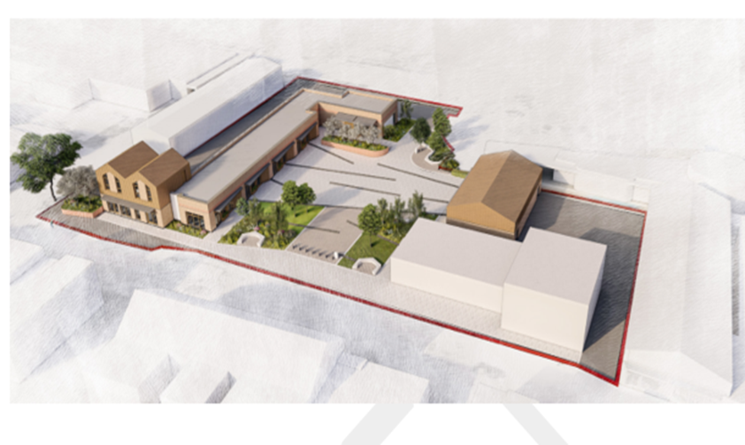
Aerial view of proposed development as Planning permission

Slide 3
Proposed new commercial units fronting Laughton Road

Slide 4
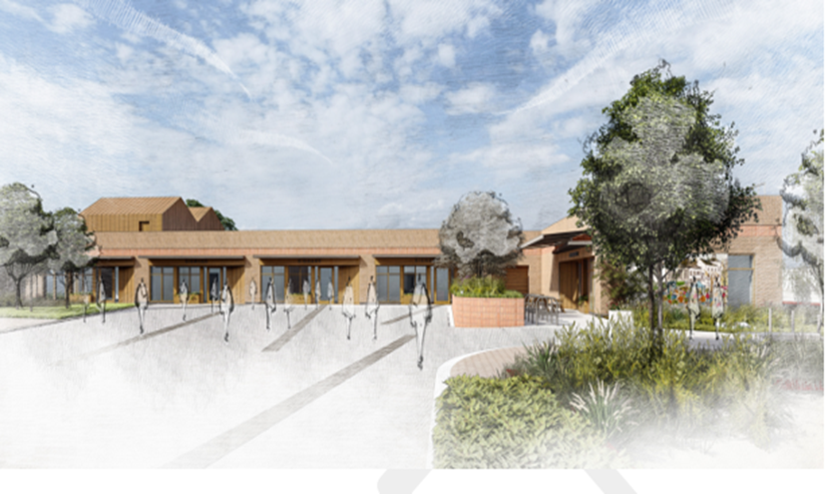
Proposed new commercial units fronting public realm

Slide 5
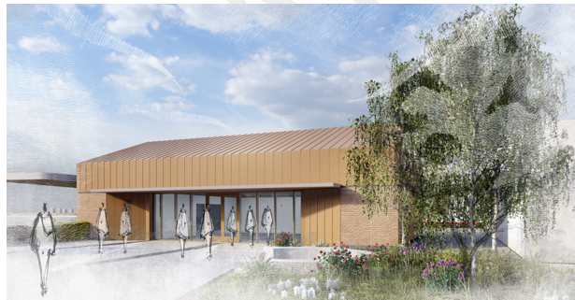
Proposed new units fronting public realm

